Slide 1
Computer Graphics
Triangles

Slide 2

Drawing Filled Triangles
+1Y
+1Z
XYZ
XY
?
-1X
+1X
XYZ
XY
XYZ
XY
-1Z
-1Y

Slide 3
Triangle Rasterization
The last type of primitive we will learn to draw on the 2D raster grid is going to be the triangle.
However, we will define them in our new 3D coordinate system.
Triangles can be connected together to form every other type of polygon, which makes them very versatile.
Nearly everything you see in a modern game or simulation is comprised of triangles.
Your current knowledge would allow you to draw the “outline” of a triangle, but not much else.
In order to “fill” a triangle with pixels, we will need to dig deeper into the math behind triangles, and how the space within a triangle is defined.

Slide 4
Review: Triangle Basics
C
SOH
a² + b² = c²
γ
CAH
α + β + γ = 180º
a
TOA
h
b
perimeter = a + b + c
β
area = ½ hc
B
c
α
A

Slide 5
Barycentric Coordinates
Defines a Non-Orthogonal coordinate system describing the space of a triangle.
Any position on this plane can be described with the following equation:
P = β( B – A ) + γ( C – A ) + A
Terms Reordered:
P = ( 1 - β - γ )A + β( B ) + γ( C )
α = ( 1 - β - γ )
P ( α, β, γ ) = αA + βB + γC
+γ
C
-β
P ( +0.4β, +1.3γ )
-γ
A
B
+β

Slide 6
Barycentric Coordinates == 3 Gradient Ratios
( 0β, 1γ, 0α )
1
1
β
α
( 1β, 0γ, 0α )
( 0β, 0γ, 1α )
1
0
0
γ
0

Slide 7
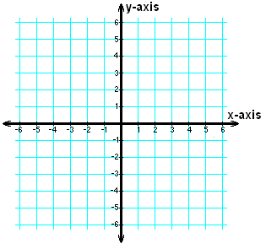
Finding the Barycentric Coordinates of a point relative to a triangle
A
β = ImplicitLineEquation ( B, line AC )
γ = ImplicitLineEquation ( C, line BA )
α = ImplicitLineEquation ( A, line CB )
b = ImplicitLineEquation ( P, line AC )
y = ImplicitLineEquation ( P, line BA )
a = ImplicitLineEquation ( P, line CB )
P_{βγα} = ( b / β , y / γ, a / α )
Could we use the Barycentric coordinates to detect if we are inside or outside the triangle? If so… how?
α
b
y
β
P
B
γ
a
C

Slide 8
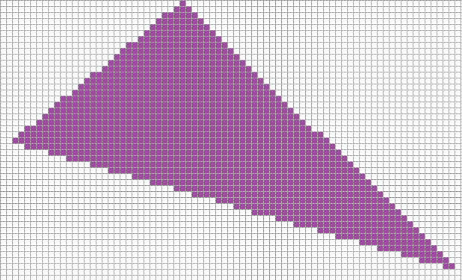
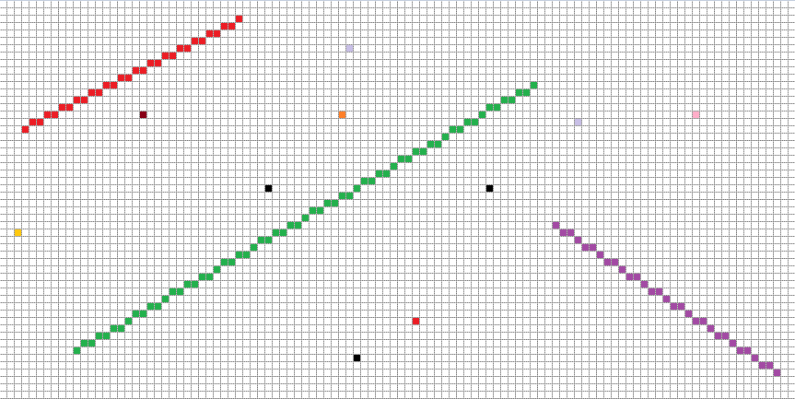
Triangle Drawing Algorithms
Positive X Axis
(0,0)
(1,0)
(2,0)
(0,1)
(1,1)
(2,1)
Positive Y Axis
(0,2)
(1,2)
(2,2)

Slide 9

Brute Triangle
X1, Y1
FOR ALL PIXELS
bya = FindBarycentric ( CurrX, CurrY )
IF b >=0 && b <= 1 &&
y >=0 && y <= 1 &&
a >=0 && a <= 1
THEN
PlotPixel ( CurrX, CurrY )
X3, Y3
X2, Y2

Slide 10
Better Brute Triangle
X1, Y1
StartX = MIN ( X1, X2, X3 )
StartY = MIN ( Y1, Y2, Y3 )
EndX = MAX ( X1, X2, X3 )
EndY = MAX ( Y1, Y2, Y3 )
FOR StartY to EndY
FOR StartX to EndX
bya = FindBarycentric ( CurrX, CurrY )
IF b >=0 && b <= 1 &&
y >=0 && y <= 1 &&
a >=0 && a <= 1
THEN
PlotPixel ( CurrX, CurrY )
X3, Y3
X2, Y2

Slide 11
Lari’s Parametric Triangle
Top
X1, Y1
Step 1: Sort the VERTS in Y Ascending.
Step 2: Determine the “Direction of Fill” by comparing the Middle vertex to the opposite line. (Use the Implicit Line Equation)
Step 3: Use the Parametric Line Equation to find the closest staring pixel for each row on the tallest line. (Top to Bottom)
Step 4: Determine if the Pixel’s center is within the Barycentric space of the triangle. If it is you should Draw that pixel.
Step 5: Continue drawing pixels on that row until you leave Barycentric space. (Ignore any pixels below the parametric line)
X3, Y3
Middle
Bottom
X2, Y2
Direction Of Fill
My personal take on rasterizing a triangle. From what I have seen this is similar to an “edge-walking” approach but with no special cases.

Slide 12
Barycentric Interpolation
Surprise! Barycentric coordinates are ALREADY ratios that add up to 1
Linear Interpolation: X = ( B – A ) * R + A
Linear written another way: X = ( B * R ) + A * ( 1 – R )
1.0 = β + γ + α So…
Barycentric Interpolation: X = A * α + B * β + C * γ
Well that was easy! =)

